Slide 1
Data Sources for Identifying Gaps
Lisa Kolovich
IMF Flickr

Slide 2
Macro-Criticality Dashboard
IMF Flickr

Slide 3
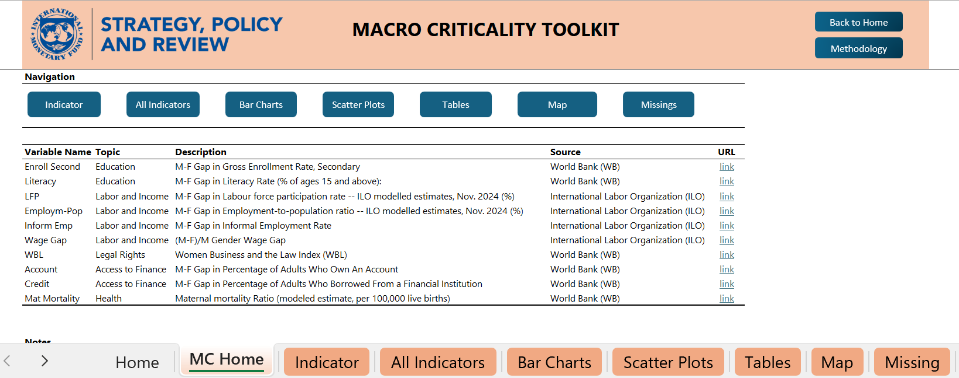
Main Gap Indicators
Select the page of interest from the tabs at the bottom of the screen
Notes:
When you open the toolkit, you’ll see eight tabs: Home, Indicator, All Indicators, Bar Charts, Scatter Plots, Tables, Map, and Missing.
The Home tab lists each female–male gap indicator, a short definition, the data source, and a link. We track about ten indicators across five topics: finance, education, health, labor and income, and legal rights.
Most gaps are shown as male minus female in percentage points; the legal-rights dimension uses the WBL index on a 0–100 scale.
When you want the full snapshot for a country, you open All Indicators.
For quick comparisons, use the Bar Charts, Scatter Plots, Tables, and Map.
Finally, the Missing tab shows how many indicators are unavailable for a country and exactly which ones—useful for prioritizing data collection

Slide 4
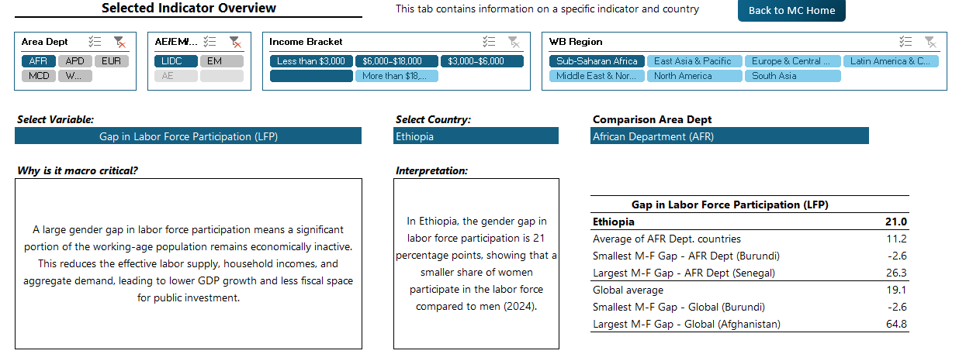
Indicator
Play with the drop-down menu, for example, choose AFR countries
Results
Select the variable of interest at the top of the screen
Select the countries of interest at the top of the screen

Slide 5
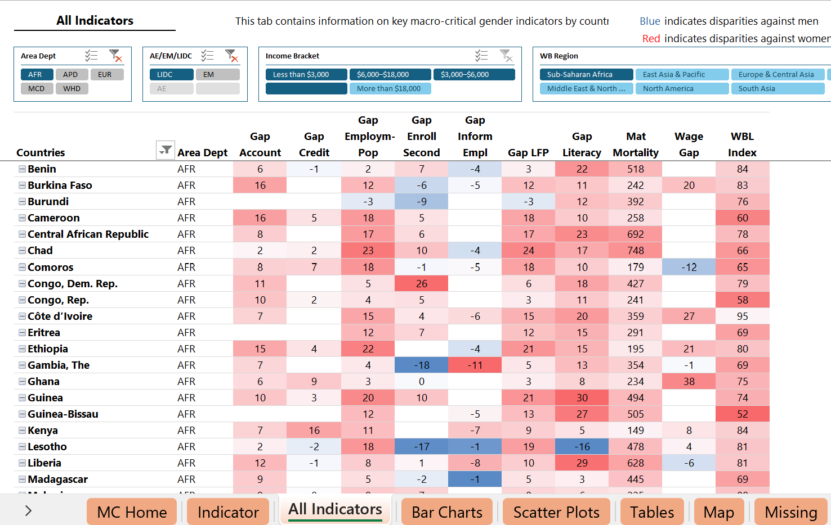
All Indicators
Play with the drop-down menu, for example, choose AFR countries
Select the countries of interest at the top of the screen
Notes:
On this page, you can see the gap for every indicator at once—useful for spotting where your country’s gaps are largest and macro-critical.
The color scheme is simple: red means the disparity is against women; blue means it’s against men.
Even at a glance, you can see many red cells across AFRcountries, particularly in areas like labor and income, finance, and legal rights.
This helps us prioritize where policy action and measurement improvements are most needed

Slide 6
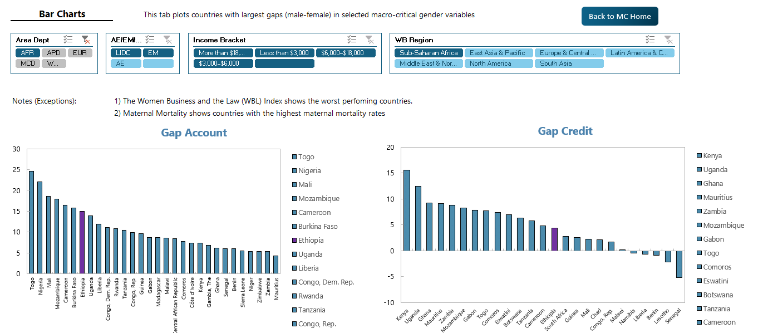
Bar Chart
Now select “Bar Charts” to benchmark with comparison countries

Slide 7
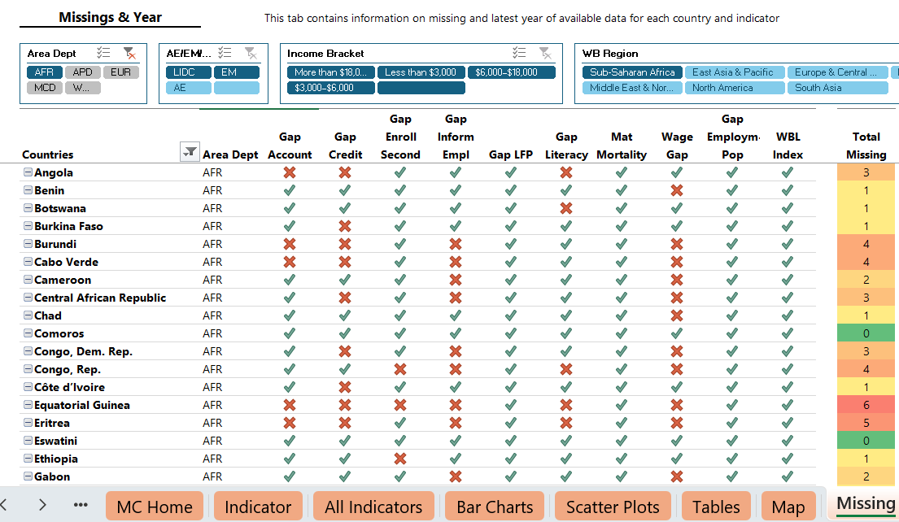
Missing
Notes:
In the missing tab, you see
The number of missing indicator by country
The name of the indictor that is missing
There is a coloring scheme where red shows a lot of missing and gree shows no missing
From our AFR countries, we can see that some of them have red coloring scheme whils have green color schem
For example, there are 6 missing indicator in EG, 5 missing indicators inEritrea, 1 missing in ETH and Eswatini has no missings

Slide 8
Group Exercise
Select your country of interest
In the All-Indicators view, which indicator(s) show the most critical female–male gaps?
Still in All-Indicators, select benchmark peers—how does your country of interest compare?
Select an indicator (Indicator view): how does the selected gap compare with regional and global averages in the dashboard?
In the Bar-chart view, which countries perform better or worse on this indicator?
In the Map tab, plot your country and its neighboring countries for one indicator—what pattern do you observe?
Based on these comparisons, what policy priorities or quick wins emerge?
Notes:
Here, we want you to do the following group exercise
Prepare PPT and present

Slide 9
World Development Indicators and Women, Business, and the Law
IMF Flickr

Slide 10
Key Resources
World Bank Gender Data Portal
Broad array of gender indicators
Customized visualizations and data download options
Women, Business, and the Law
Over 50 years of data on legal barriers
190 countries
Data visualization, downloads

Slide 11
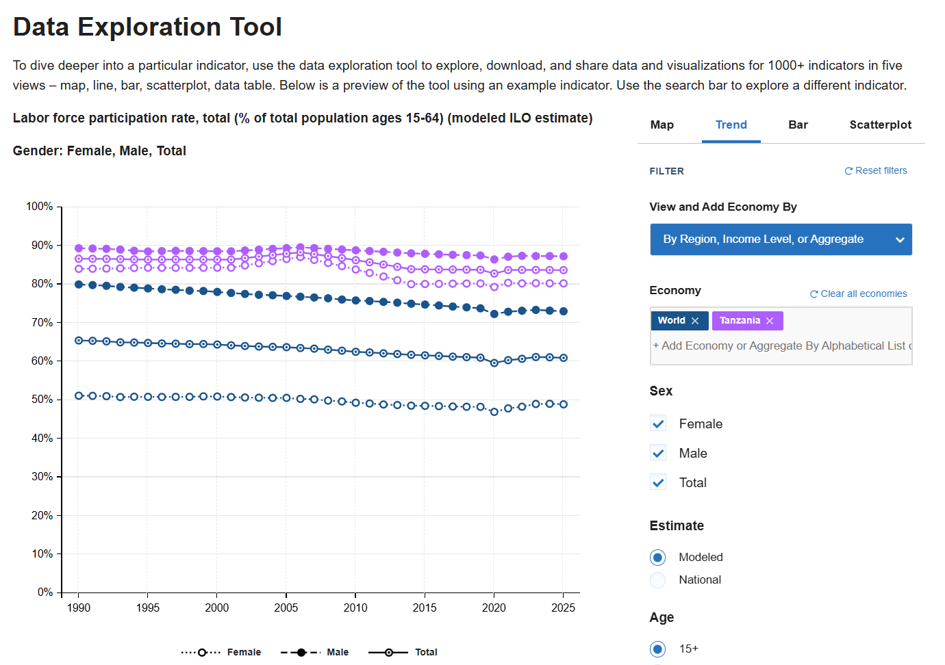
Gender Data Portal

Slide 12
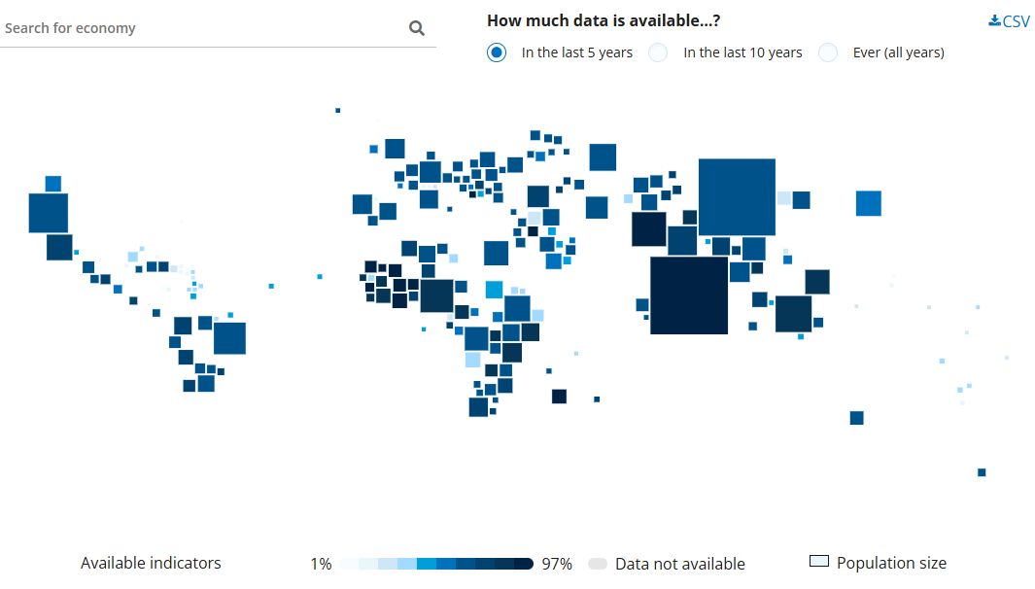
World Bank Gender Data Portal: Data Availability

Slide 13
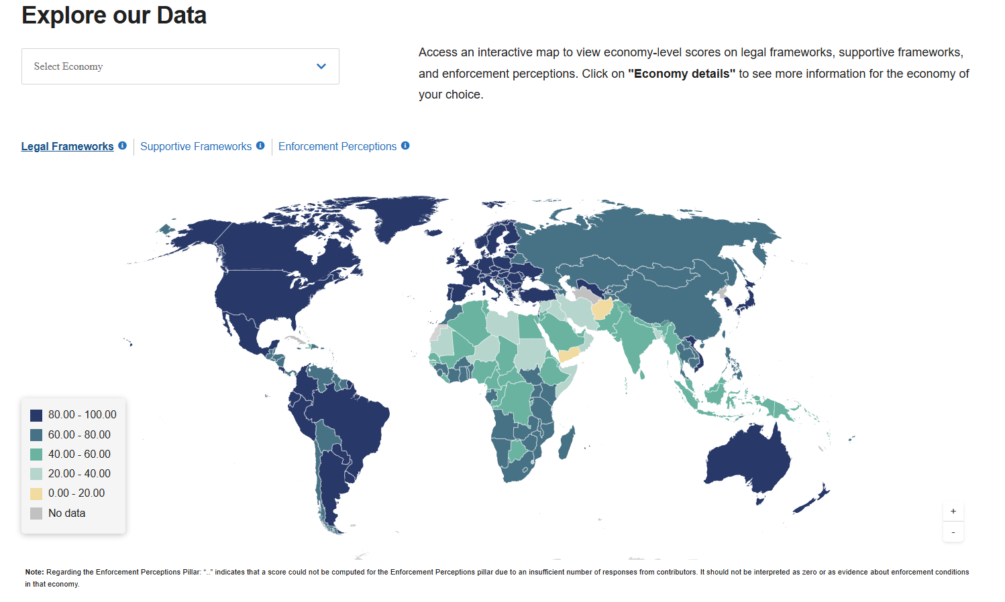
Women, Business, and the Law Index

Slide 14
ILO Care Portal

Slide 15
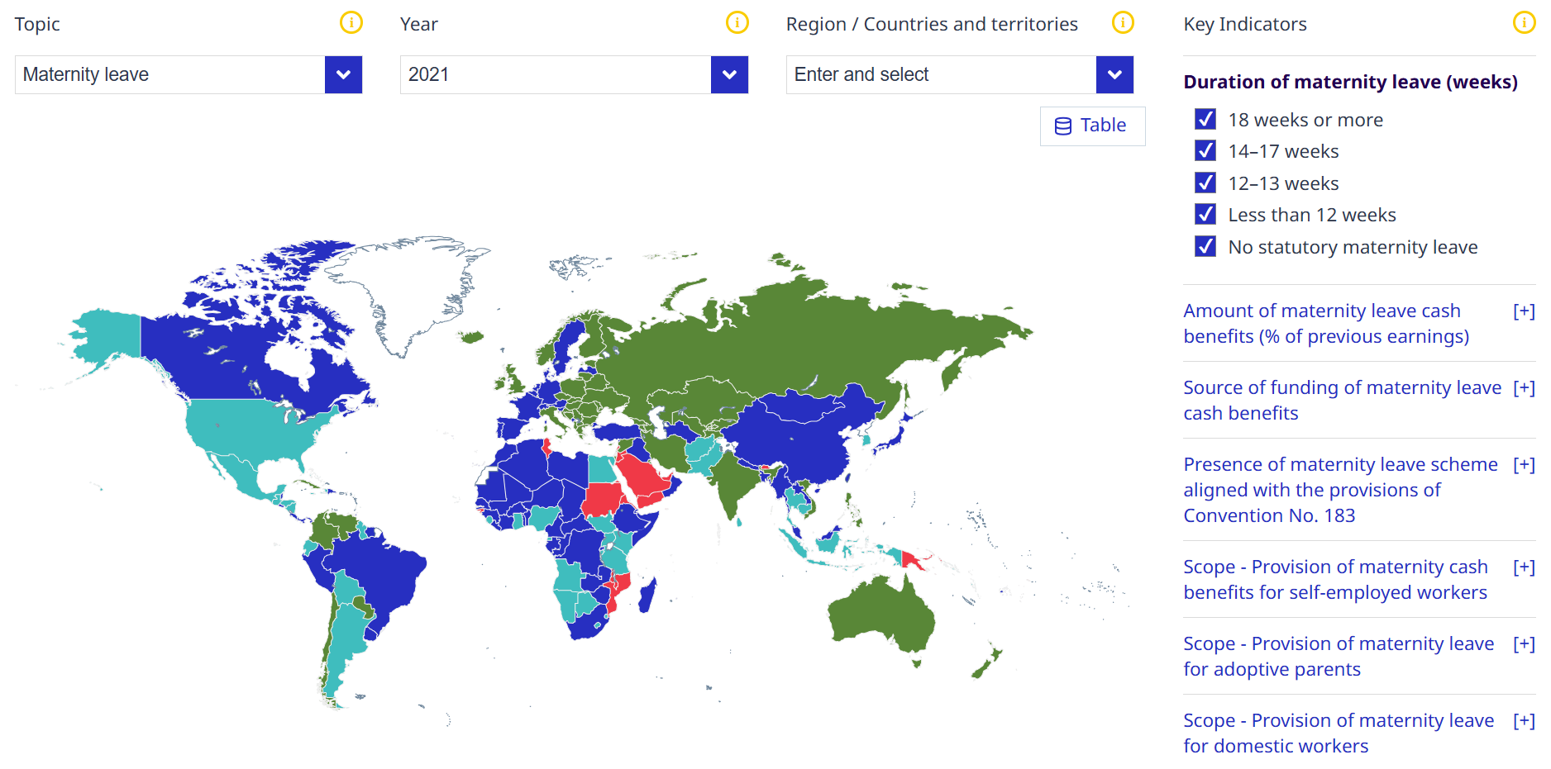
ILO Global Care Portal

Slide 16
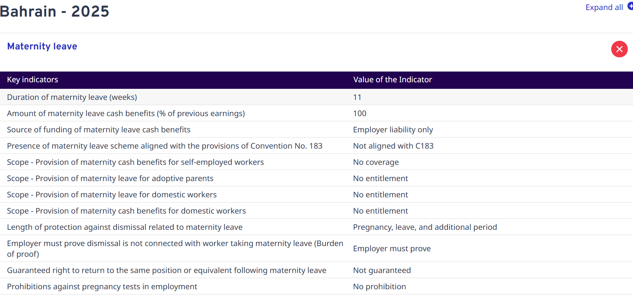
ILO Global Care Portal

Slide 17
Links and Resources
STATcompiler
Life in Transition IV Visualizer
ILO Labor force suveys
ILOSTAT data explorer
WB Enterprise Surveys & gender
WB Gender Data Portal
UN Women Thematic Area Dashboard

Slide 18
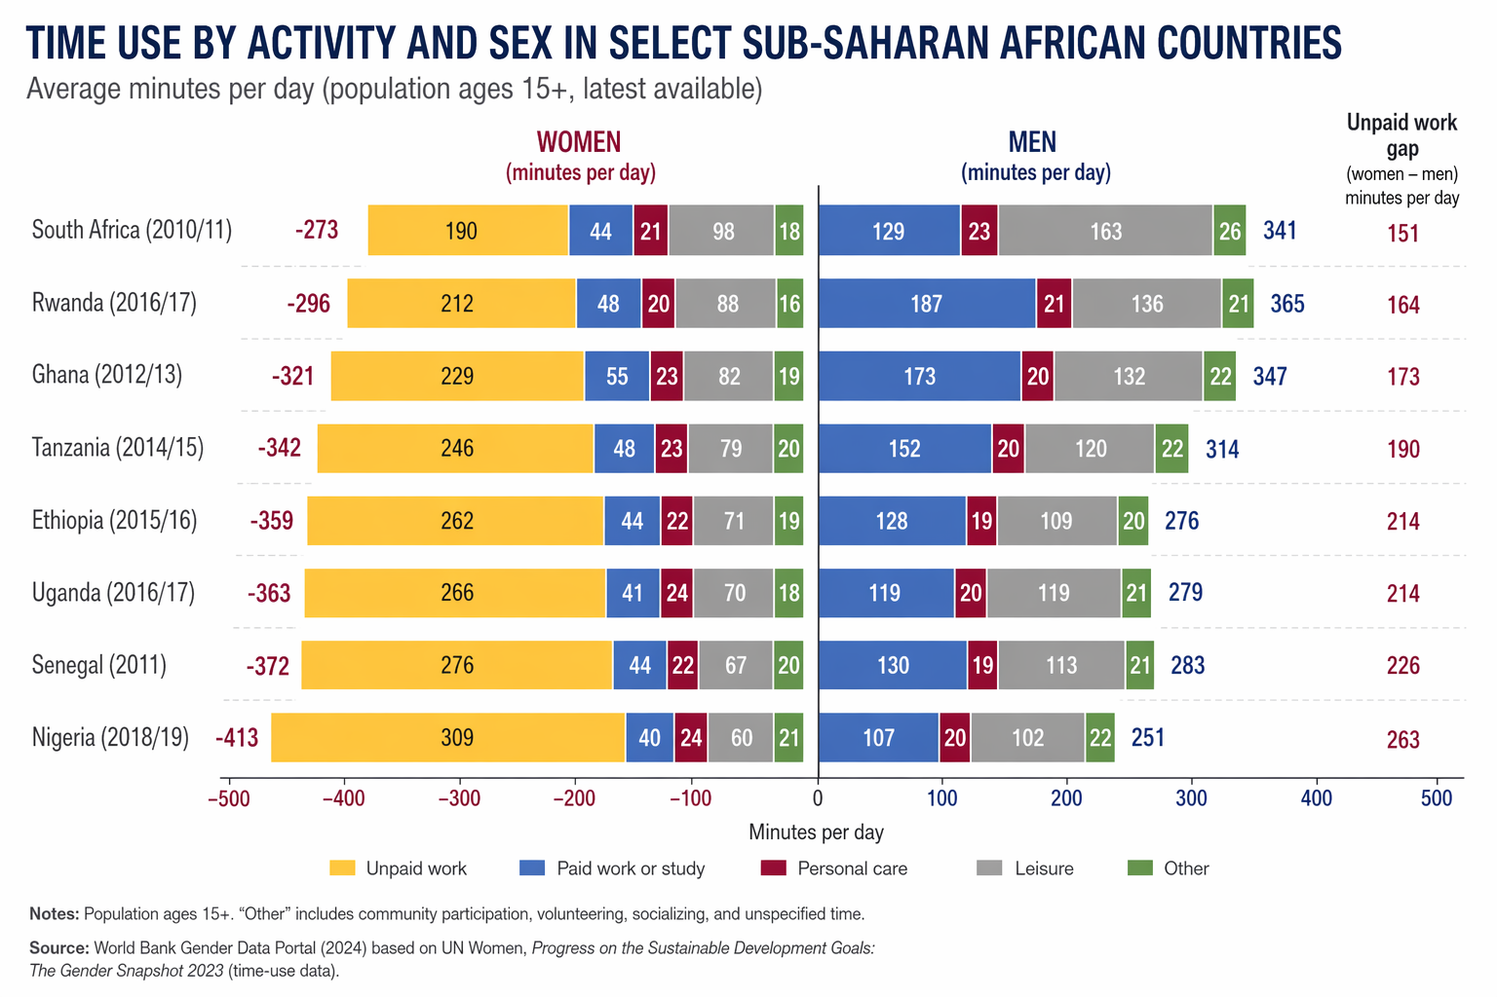
Women spend more time on unpaid work
Figure: Minutes per day, M - F
Notes:
OECD time use data based on people of age between 15 to 64.
Demographics is not a stand-alone issue. The choice of fertility, labor market participation and human capital are linked joint decisions.
When households make these choices, they roughly have two constraints, time allocation and resource allocation. The time constraint, resource constraint, together with the distribution of household bargaining power and preferences shape the fertility and work decisions of households.
This framework allows us to think of the diverging demographic trends in a unified framework.
On the left, we present the time allocation of by male and female. As you see, women tend to spend more time on unpaid work and men tend to spend more time on paid work and leisure.
In a setting where barriers for women to participate in labor market is high, women tend to spend more time in unpaid work. They may have more children, but due to the limited resources, they may choose to invest less in the education of each child.
When we think of policies, we can think about how polices can address each of the constraints:
For example, transportation and road infrastructure could reduce the time women spent on fetching water, and allow them more time for other activates such as paid work, so it could relax both time and resource constraint.
Subsidized schooling can help household overcome the resource constraint and at the same time allow the household member who use to watch the children some free time for other activities.
Designing polices to facilitate women’s work-life choice, increasing female’s participation in the paid economic activities contributes to a more inclusive and resilient macro economy.

